Slide 1

Hidden leady illusion demo
https://youtu.be/Z3rijt3P8pE

Slide 2




Slide 3


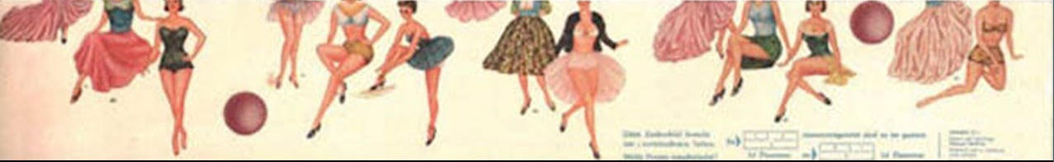
7
1
10
4
8
13
2
5
11
14
6
9
12
3

Slide 4
7
13
1
10
4
8
14
2
5
11
15
6
9
12
3

Slide 5
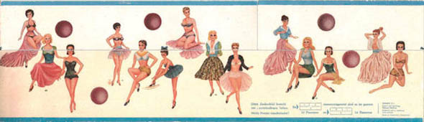
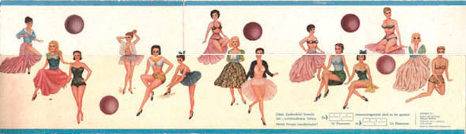

Slide 7
1
2
3
4
5

Slide 8


Slide 9

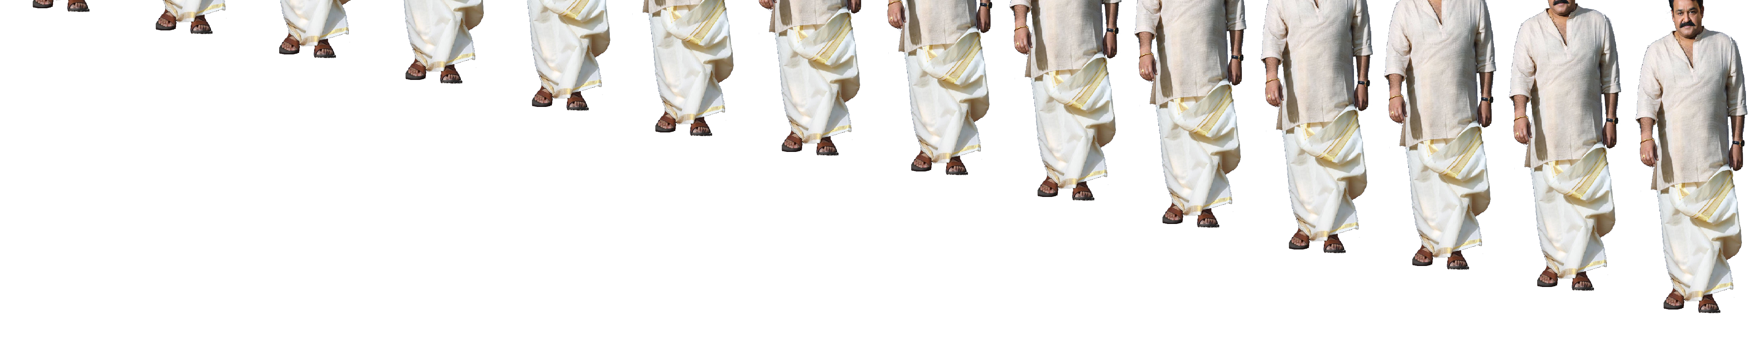
1
2
3
4
5
6
7
8
9
10
11
12
13
14
15

Slide 10
1
3
2
4
1
2
3
4

